Slide 1



UNIT 2
Lesson 7
IN SYNC WITH YOUR PARENTS
Part 4

Slide 2
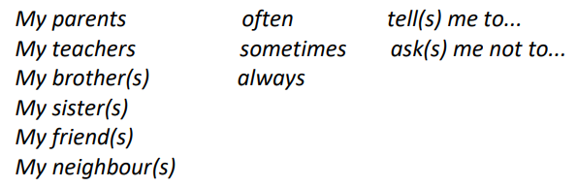
Display your stories and read them. In the end, have a feedback discussion.
BRAINSTORMING
COMMANDS
REQUESTS
I have noisy neighbours and I often hear them ordering their children around. Among other things, I often hear: ‘Keep your room tidy!’
‘Don’t play that stupid music.’ etc.
Say what your parents/teachers/brothers/sisters, etc., tell you to do or not to do, using the commands
and requests below.
They say to keep their room tidy.
They say not to play that stupid music.

Slide 3

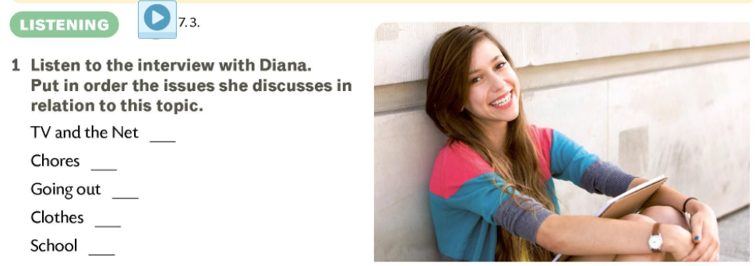

Slide 4
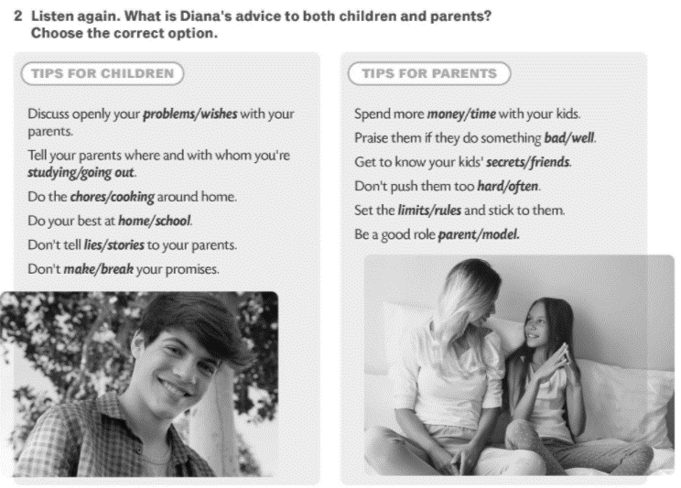
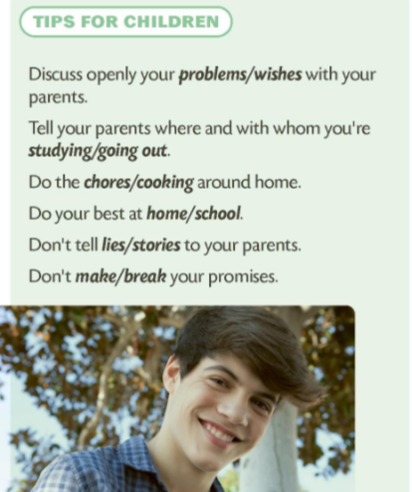
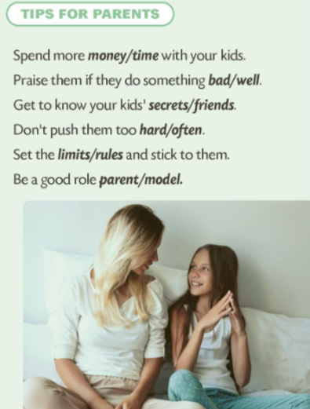
Listen to the tips for children first.
Report on the tips. Which ones you agree with, if any, and why you
don’t agree with some tips if any.

Slide 5
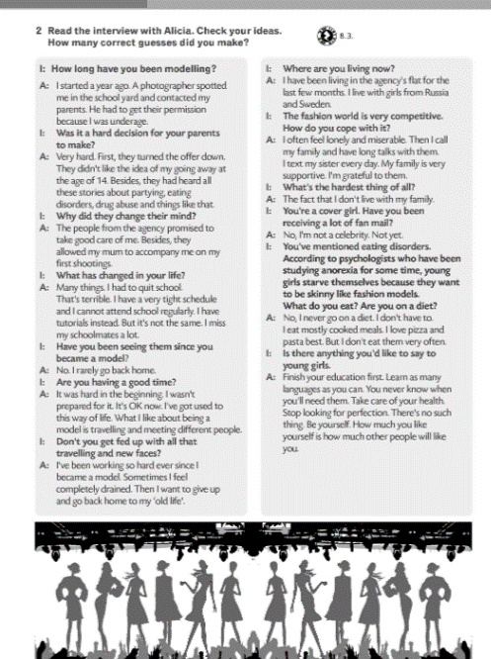
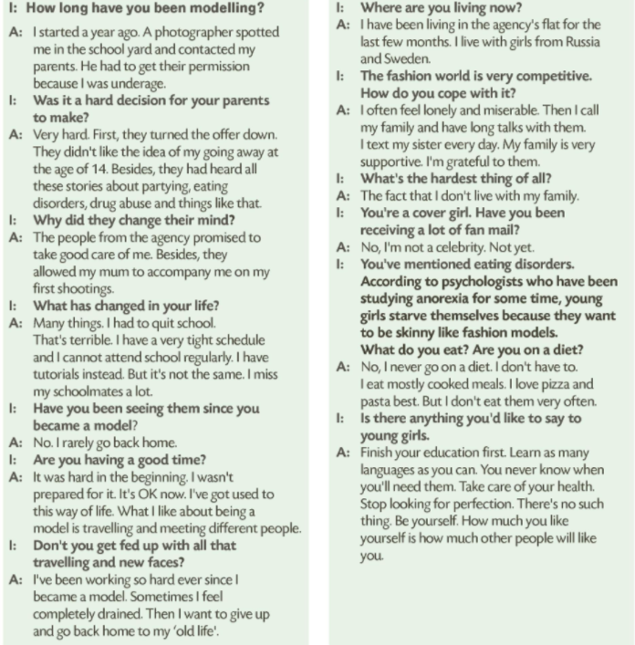


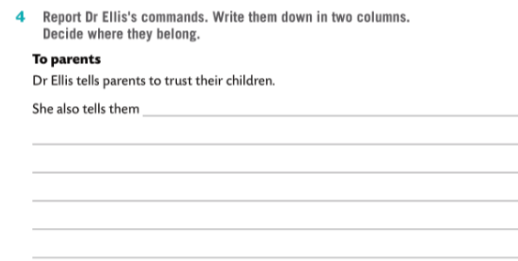
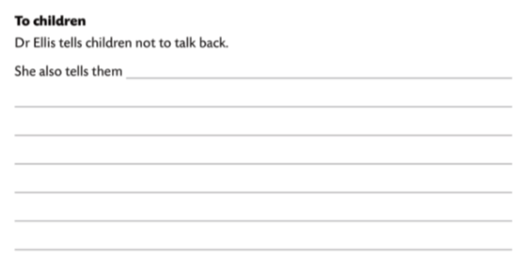

Slide 6
